Slide 1
Making Big data simple with Apache Spark

Slide 2
Outline:
The Big data problem
Spark programming model
Open source community
Trying it out

Slide 3
Apache Spark
Open source engine for data processing on clusters
lets you write functions locally and automatically run them on cluster.
Most Active open source project in big data

Slide 4
Big data problem
Data is growing faster than computation speeds
growing data sources
web, mobile, scientific
cheap storage
doubling every 18 months
stalling CPU speeds

Slide 5
Examples
Facebook daily logs : 60 TB
1000 genomes projects : 200TB
Google web index : 10+ PB
Cost of 1 TB of disk : $30
Time to read 1 TB from disk: 6 hours (50MB/s)

Slide 6
The Big data problem
Single machine can no longer process or even store all the data
Only solution is to distribute over large clusters

Slide 7
Why a New Programming Model?
MapReduce greatly simplified big data analysis
But as soon as it got popular, users wanted more:
More complex, multi-stage applications (e.g. iterative graph algorithms and machine learning)
More interactive ad-hoc queries
Both multi-stage and interactive apps require faster data sharing across parallel jobs

Slide 8
Data Sharing in MapReduce
HDFS read
HDFS write
HDFS read
HDFS write
iter. 1
iter. 2
. . .
Input
HDFS read
query 1
result 1
query 2
result 2
query 3
result 3
Input
. . .
Slow due to replication, serialization, and disk IO
Notes:
Each iteration is, for example, a MapReduce job

Slide 9
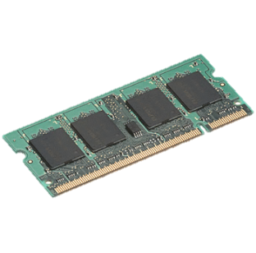
Data Sharing in Spark
iter. 1
iter. 2
. . .
Input
query 1
one-time processing
query 2
query 3
Input
Distributed memory
. . .
10-100× faster than network and disk

Slide 10
Spark Programming Model
Write programs in terms of transformations on distributed datasets
Resilient Distributed Datasets
Collections of objects spread across a cluster, stored in RAM or on Disk
Built through parallel transformations
Automatically rebuilt on failure

Slide 11
Resilient distributed datasets (RDDs)
Immutable, partitioned collections of objects
Created through parallel transformations (map, filter, groupBy, join, …) on data in stable storage
Can be cached for efficient reuse
Actions on RDDs
Count, reduce, collect, save, …

Slide 12
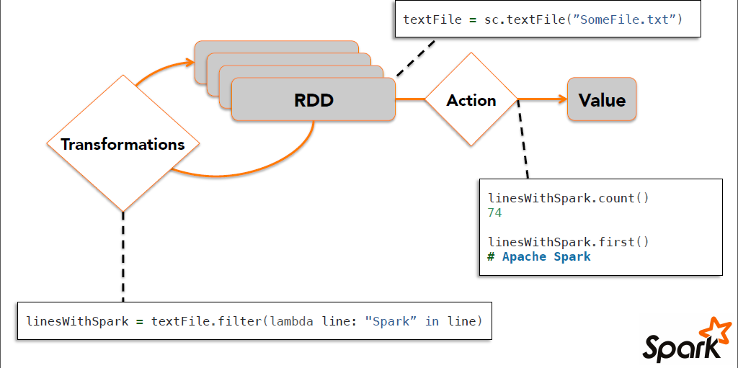
Working with RDDS

Slide 13
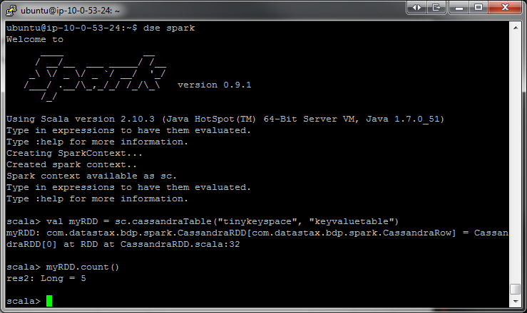
Interactive shell
(Scala & Python only)

Slide 14
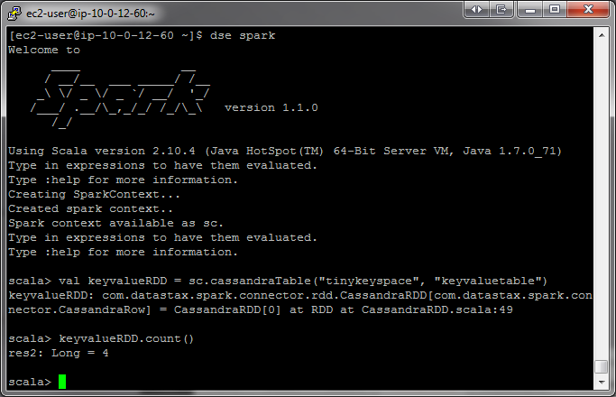
W
Ex
RDD
T
Driver Program
RDD
T
Worker Machine
W
Ex
RDD
T
RDD
T
Worker Machine
Notes:
When you start a driver program, it connects to the Spark Cluster
You can make the Driver HA in standalone by setting the Boolean for –supervise to true when using Spark Submit (https://github.com/apache/spark/search?utf8=%E2%9C%93&q=supervise)
In YARN the driver is HA via YARN primitives

Slide 15
more partitions = more parallelism
RDD
item-1
item-2
item-3
item-4
item-5
item-6
item-7
item-8
item-9
item-10
item-11
item-12
item-13
item-14
item-15
item-16
item-17
item-18
item-19
item-20
item-21
item-22
item-23
item-24
item-25
W
W
W
Ex
Ex
Ex
RDD
RDD
RDD
RDD
RDD
Notes:
This RDD has 5 partitions.
An RDD is simply a distributed collection of elements. You can think of the distributed collections like of like an array or list in your single machine program, except that it’s spread out across multiple nodes in the cluster.
In Spark all work is expressed as either creating new RDDs, transforming existing RDDs, or calling operations on RDDs to compute a result. Under the hood, Spark automatically distributes the data contained in RDDs across your cluster and parallelizes the operations you perform on them.
So, Spark gives you APIs and functions that lets you do something on the whole collection in parallel using all the nodes.

Slide 16
RDD w/ 4 partitions
Error, ts, msg1
Warn, ts, msg2
Error, ts, msg1
Info, ts, msg8
Warn, ts, msg2
Info, ts, msg8
Error, ts, msg3
Info, ts, msg5
Info, ts, msg5
Error, ts, msg4
Warn, ts, msg9
Error, ts, msg1
logLinesRDD
An RDD can be created 2 ways:
- Parallelize a collection
- Read data from an external source (S3, C*, HDFS, etc)
Notes:
----- Meeting Notes (6/15/15 15:53) -----
Each data source feeds the partitions differently.
e.g., Each HDFS block maps to a partition. In Cassandra, by default, 100,000 rows per partition.

Slide 17


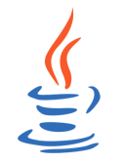
Parallelize
# Parallelize in Python
wordsRDD = sc.parallelize([“fish", “cats“, “dogs”])
Take an existing in-memory collection and pass it to SparkContext’s parallelize method
Not generally used outside of prototyping and testing since it requires entire dataset in memory on one machine
// Parallelize in Scala
val wordsRDD= sc.parallelize(List("fish", "cats", "dogs"))
// Parallelize in Java
JavaRDD<String> wordsRDD = sc.parallelize(Arrays.asList(“fish", “cats“, “dogs”));

Slide 18
Read from text file
# Read a local txt file in Python
linesRDD = sc.textFile("/path/to/README.md")
There are other methods to read data from HDFS, C*, S3, HBase, etc.
// Read a local txt file in Scala
val linesRDD = sc.textFile("/path/to/README.md")
// Read a local txt file in Java
JavaRDD<String> lines = sc.textFile("/path/to/README.md");

Slide 19




Error, ts, msg1
Warn, ts, msg2
Error, ts, msg1
Info, ts, msg8
Warn, ts, msg2
Info, ts, msg8
Error, ts, msg3
Info, ts, msg5
Info, ts, msg5
Error, ts, msg4
Warn, ts, msg9
Error, ts, msg1
logLinesRDD
(input/base RDD)
.filter( )
Error, ts, msg1
Error, ts, msg1
Error, ts, msg3
Error, ts, msg4
Error, ts, msg1
errorsRDD
Notes:
Introduce that Spark has Operations which can be transformations or actions.
Those are 4 green unique blocks in a single HDFS file
Here we are filtering out the warnings and info messages so we are left with just errors in the RDD.
This doesn’t actually read the file from HDFS just yet… we’re just building out a lineage graph

Slide 20

Error, ts, msg1
Error, ts, msg1
Error, ts, msg3
Error, ts, msg4
Error, ts, msg1
errorsRDD
.coalesce( 2 )
Error, ts, msg1
Error, ts, msg3
Error, ts, msg1
Error, ts, msg4
Error, ts, msg1
cleanedRDD
.collect( )
Driver

Slide 21
Execute DAG!
.collect( )
Driver
Notes:
directed acyclic graph.
That is, it is formed by a collection of vertices and directed edges, each edge connecting one vertex to another, such that there is no way to start at some vertex v and follow a sequence of edges that eventually loops back to v again.
A collection of tasks that must be ordered into a sequence, subject to constraints that certain tasks must be performed earlier than others, may be represented as a DAG with a vertex for each task and an edge for each constraint
https://en.wikipedia.org/wiki/Directed_acyclic_graph

Slide 22
logLinesRDD
.collect( )
Driver

Slide 23

logLinesRDD
.filter( )
errorsRDD
.coalesce( 2 )
cleanedRDD
.collect( )
Error, ts, msg1
Error, ts, msg3
Error, ts, msg1
Error, ts, msg4
Error, ts, msg1
Driver

Slide 24
logLinesRDD
.filter( )
errorsRDD
.coalesce( 2, shuffle= False)
Pipelined
Stage-1
cleanedRDD
.collect( )
data
Driver
Notes:
----- Meeting Notes (6/15/15 16:02) -----
This is a stage (which we'll talk about later).

Slide 25
logLinesRDD
errorsRDD
cleanedRDD
Driver
Notes:
Now the RDDs dissapear and get destroyed

Slide 26
data
Driver

Slide 27



logLinesRDD
errorsRDD
.saveToCassandra( )
Error, ts, msg1
Error, ts, msg3
Error, ts, msg1
Error, ts, msg4
Error, ts, msg1
cleanedRDD
.filter( )
Error, ts, msg1
Error, ts, msg1
Error, ts, msg1
.count( )
5
errorMsg1RDD
.collect( )

Slide 28

logLinesRDD
errorsRDD
.saveToCassandra( )
Error, ts, msg1
Error, ts, msg3
Error, ts, msg1
Error, ts, msg4
Error, ts, msg1
cleanedRDD
.filter( )
Error, ts, msg1
Error, ts, msg1
Error, ts, msg1
.count( )
5
errorMsg1RDD
.collect( )
Notes:
It’s okay if only part of the RDD actually fits in memory
Talk about lineage: parent RDD and child RDD

Slide 29
Lifecycle of a Spark program
Create some input RDDs from external data or parallelize a collection in your driver program.
Lazily transform them to define new RDDs using transformations like filter() or map()
Ask Spark to cache() any intermediate RDDs that will need to be reused.
Launch actions such as count() and collect() to kick off a parallel computation, which is then optimized and executed by Spark.
Notes:
----- Meeting Notes (6/15/15 16:08) -----
Also note that an application can have many such 1 through 4 procedures.

Slide 30
Transformations
(lazy)
map() | intersection() | cartesion()
flatMap() | distinct() | pipe()
filter() | groupByKey() | coalesce()
mapPartitions() | reduceByKey() | repartition()
mapPartitionsWithIndex() | sortByKey() | partitionBy()
sample() | join() | ...
union() | cogroup() | ...
Most transformations are element-wise (they work on one element at a time), but this is not true for all transformations

Slide 31
Actions
reduce() | takeOrdered()
collect() | saveAsTextFile()
count() | saveAsSequenceFile()
first() | saveAsObjectFile()
take() | countByKey()
takeSample() | foreach()
saveToCassandra() | ...
Notes:
Actions force the evaluation of the transformations required for the RDD they are called on, since they are required to actually produce output.

Slide 32
Types of RDDs
HadoopRDD
FilteredRDD
MappedRDD
PairRDD
ShuffledRDD
UnionRDD
PythonRDD
DoubleRDD
JdbcRDD
JsonRDD
SchemaRDD
VertexRDD
EdgeRDD
CassandraRDD (DataStax)
GeoRDD (ESRI)
EsSpark (ElasticSearch)

Slide 33

Example: Log Mining
Load error messages from a log into memory, then interactively search for various patterns
Base RDD
Transformed RDD
Cache 1
lines = spark.textFile(“hdfs://...”)
errors = lines.filter(lambda s: s.startswith(“ERROR”))
messages = errors.map(lambda s: s.split(“\t”)[2])
messages.cache()
results
Worker
tasks
Block 1
Driver
Action
messages.filter(lambda s: “mysql” in s).count()
Cache 2
messages.filter(lambda s: “php” in s).count()
Worker
Cache 3
. . .
Full-text search of Wikipedia
60GB on 20 EC2 machine
0.5 sec vs. 20s for on-disk
Worker
Block 2
Block 3
Notes:
Add “variables” to the “functions” in functional programming

Slide 34
Scaling Down
Notes:
Gracefully

Slide 35
Fault Recovery
RDDs track lineage information that can be used to efficiently recompute lost data
msgs = textFile.filter(lambda s: s.startsWith(“ERROR”))
.map(lambda s: s.split(“\t”)[2])
HDFS File
Filtered RDD
Mapped RDD
filter (func = startsWith(…))
map (func = split(...))

Slide 36
More RDD Operators
map
filter
groupBy
sort
union
join
leftOuterJoin
rightOuterJoin
reduce
count
fold
reduceByKey
groupByKey
cogroup
cross
zip
sample
take
first
partitionBy
mapWith
pipe
save ...

Slide 37
Programming with RDD’s

Slide 38
SparkContext
Main entry point to Spark functionality
Available in shell as variable sc
In standalone programs, you’d make your own

Slide 39
Creating RDDs
# Turn a Python collection into an RDD
sc.parallelize([1, 2, 3])
# Load text file from local FS, HDFS, or S3
sc.textFile(“file.txt”)
sc.textFile(“directory/*.txt”)
sc.textFile(“hdfs://namenode:9000/path/file”)
# Use existing Hadoop InputFormat (Java/Scala only)
sc.hadoopFile(keyClass, valClass, inputFmt, conf)

Slide 40
Basic Transformations
nums = sc.parallelize([1, 2, 3])
# Pass each element through a function
squares = nums.map(lambda x: x*x) // {1, 4, 9}
# Keep elements passing a predicate
even = squares.filter(lambda x: x % 2 == 0) // {4}
# Map each element to zero or more others
nums.flatMap(lambda x: => range(x)).collect()
# => {0, 0, 1, 0, 1, 2}
Range object (sequence of numbers 0, 1, …, x-1)
Notes:
All lazy

Slide 41
Basic Actions
nums = sc.parallelize([1, 2, 3])
# Retrieve RDD contents as a local collection
nums.collect() # => [1, 2, 3]
# Return first K elements
nums.take(2) # => [1, 2]
# Count number of elements
nums.count() # => 3
# Merge elements with an associative function
nums.reduce(lambda x, y: x + y) # => 6
# Write elements to a text file
nums.saveAsTextFile(“hdfs://file.txt”)
Notes:
Launch computations

Slide 42
Working with Key-Value Pairs
Spark’s “distributed reduce” transformations operate on RDDs of key-value pairs
Python: pair = (a, b) pair[0] # => a pair[1] # => b
Scala: val pair = (a, b) pair._1 // => a pair._2 // => b
Java: Tuple2 pair = new Tuple2(a, b); pair._1 // => a pair._2 // => b

Slide 43
Some Key-Value Operations
pets = sc.parallelize( [(“cat”, 1), (“dog”, 1), (“cat”, 2)])
pets.reduceByKey(lambda x, y: x + y) # => {(cat, 3), (dog, 1)}
pets.groupByKey() # => {(cat, [1, 2]), (dog, [1])}
pets.sortByKey() # => {(cat, 1), (cat, 2), (dog, 1)}
reduceByKey also automatically implements combiners on the map side

Slide 44
Example: Word Count
lines = sc.textFile(“sample.txt”)
counts = lines.flatMap(lambda line: line.split(“ ”)) .map(lambda word : (word, 1)) .reduceByKey(lambda x, y: x + y)
“to” “be” “or”
(to, 1) (be, 1) (or, 1)
(be, 2) (not, 1)
“to be or”
“not” “to” “be”
(not, 1) (to, 1) (be, 1)
(or, 1)
(to, 2)
“not to be”

Slide 45
Other Key-Value Operations
visits = sc.parallelize([ (“index.html”, “1.2.3.4”), (“about.html”, “3.4.5.6”), (“index.html”, “1.3.3.1”) ])
pageNames = sc.parallelize([ (“index.html”, “Home”), (“about.html”, “About”) ])
visits.join(pageNames) # (“index.html”, (“1.2.3.4”, “Home”)) # (“index.html”, (“1.3.3.1”, “Home”)) # (“about.html”, (“3.4.5.6”, “About”))

Slide 46
Setting the Level of Parallelism
All the pair RDD operations take an optional second parameter for number of tasks
words.reduceByKey(lambda x, y: x + y, 5)
words.groupByKey(5)
visits.join(pageViews, 5)

Slide 47
Using Local Variables
Any external variables you use in a closure will automatically be shipped to the cluster:
query = sys.stdin.readline()
pages.filter(lambda x: query in x).count()
Some caveats:
Each task gets a new copy (updates aren’t sent back)
Variable must be Serializable / Pickle-able
Don’t use fields of an outer object (ships all of it!)

Slide 48
Under The Hood: DAG Scheduler
General task graphs
Automatically pipelines functions
Data locality aware
Partitioning aware to avoid shuffles
B:
A:
F:
Stage 1
groupBy
C:
D:
E:
join
Stage 2
map
filter
Stage 3
= RDD
= cached partition
Notes:
NOT a modified version of Hadoop

Slide 49
How to Run Spark

Slide 50
Language Support
Python
lines = sc.textFile(...) lines.filter(lambda s: “ERROR” in s).count()
Standalone Programs
Python, Scala, & Java
Interactive Shells
Python & Scala
Performance
Java & Scala are faster due to static typing
…but Python is often fine
Scala
val lines = sc.textFile(...) lines.filter(x => x.contains(“ERROR”)).count()
Java
JavaRDD<String> lines = sc.textFile(...); lines.filter(new Function<String, Boolean>() { Boolean call(String s) { return s.contains(“error”); } }).count();

Slide 51
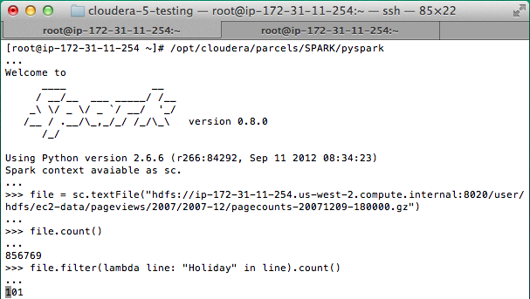
Interactive Shell(REPL)
The Fastest Way to Learn Spark
Available in Python and Scala
Runs as an application on an existing Spark Cluster…
OR Can run locally
Notes:
The barrier to entry for working with the spark API is minimal

Slide 52
… or a Standalone Application
import sys
from pyspark import SparkContext
if __name__ == "__main__":
sc = SparkContext( “local”, “WordCount”, sys.argv[0], None) lines = sc.textFile(sys.argv[1])
counts = lines.flatMap(lambda s: s.split(“ ”)) \ .map(lambda word: (word, 1)) \ .reduceByKey(lambda x, y: x + y) counts.saveAsTextFile(sys.argv[2])

Slide 53
Create a SparkContext
import org.apache.spark.SparkContext
import org.apache.spark.SparkContext._
val sc = new SparkContext(“url”, “name”, “sparkHome”, Seq(“app.jar”))
Scala
Cluster URL, or local / local[N]
App name
Spark install path on cluster
List of JARs with app code (to ship)
import org.apache.spark.api.java.JavaSparkContext;
JavaSparkContext sc = new JavaSparkContext(
“masterUrl”, “name”, “sparkHome”, new String[] {“app.jar”}));
Java
from pyspark import SparkContext
sc = SparkContext(“masterUrl”, “name”, “sparkHome”, [“library.py”]))
Python
Notes:
Mention assembly JAR in Maven etc
Use the shell with your own JAR`

Slide 54
Add Spark to Your Project
Scala / Java: add a Maven dependency on
groupId: org.spark-project artifactId: spark-core_2.10 version: 0.9.0
Python: run program with our pyspark script

Slide 55
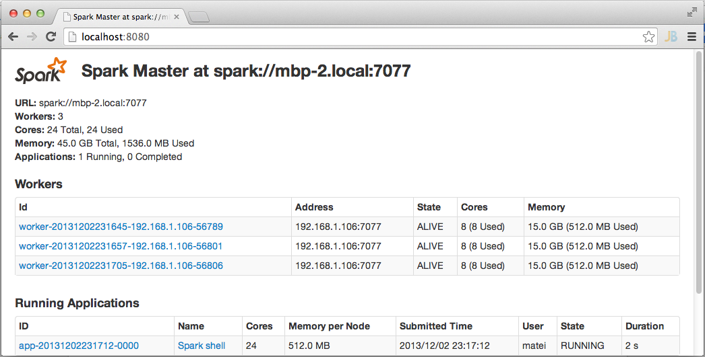
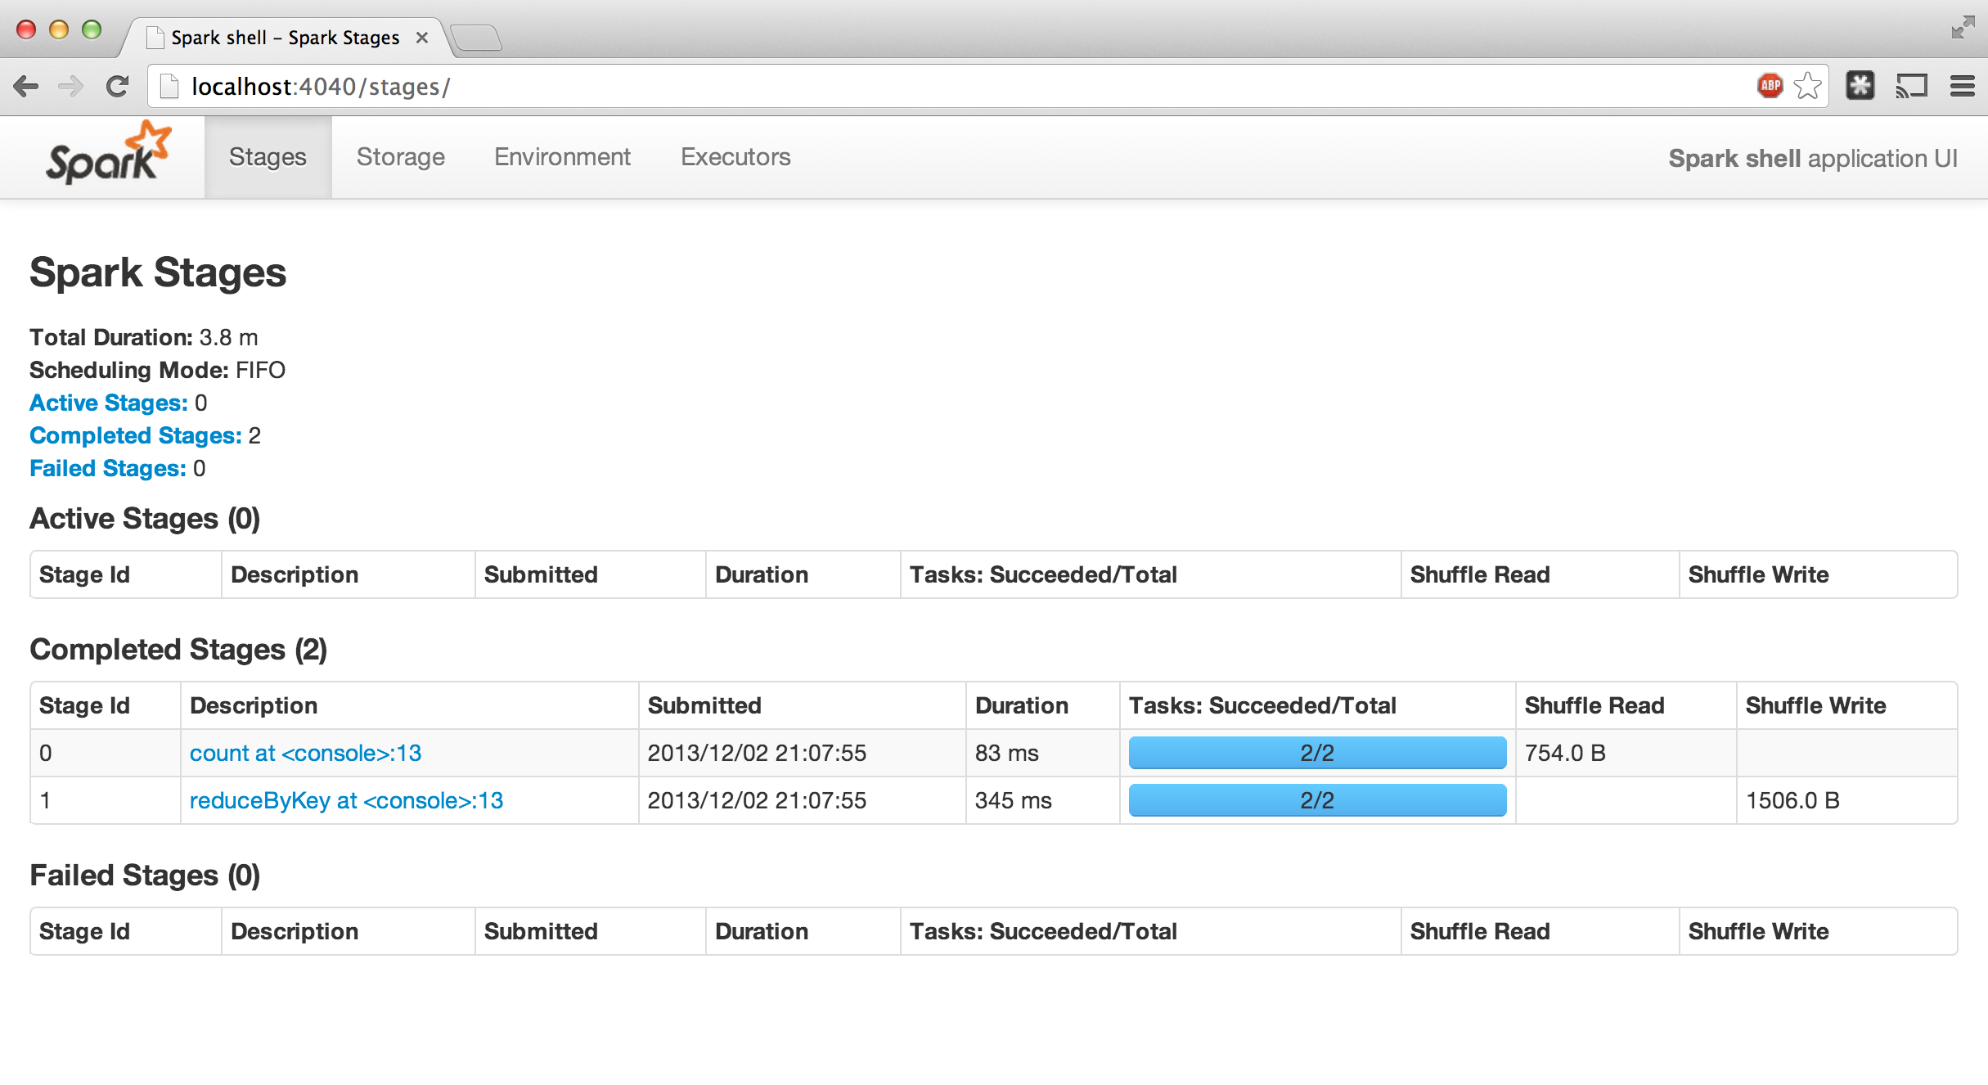
Administrative GUIs
http://<Standalone Master>:8080 (by default)

Slide 56
Software Components
Spark runs as a library in your program (1 instance per app)
Runs tasks locally or on cluster
Mesos, YARN or standalone mode
Accesses storage systems via Hadoop InputFormat API
Can use HBase, HDFS, S3, …
Your application
SparkContext
Cluster manager
Local threads
Worker
Worker
Spark executor
Spark executor
HDFS or other storage

Slide 57
Software Stack
Shark (Hive on Spark)
Spark SQL
Streaming Spark
…
Spark
Local mode
EC2
Apache Mesos
YARN

Slide 58
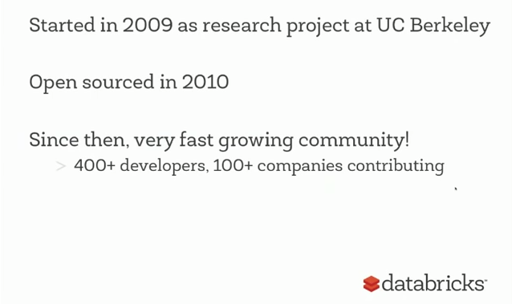
Spark History

Slide 59
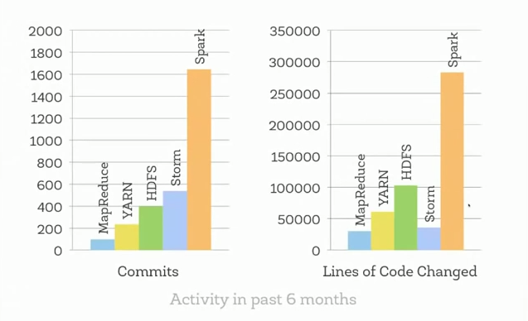
Compared to Other Projects

Slide 60
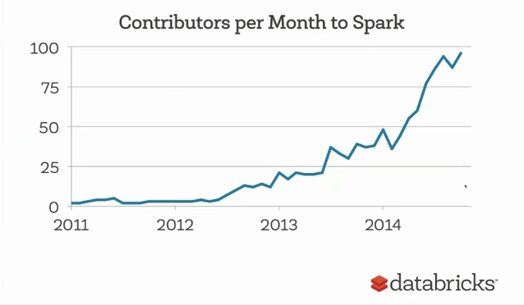
Community Growth

Slide 61
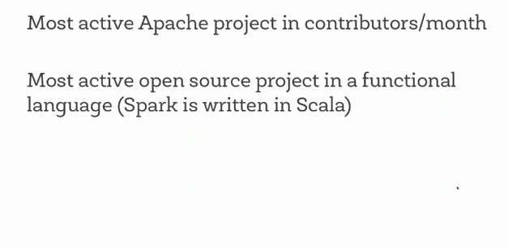
Community Stats

Slide 62
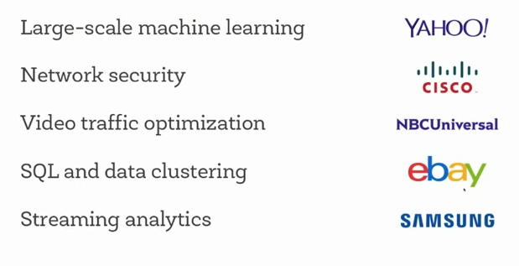
Commercial Users

Slide 63
Spark 1.4
most active open source project
new language R
largest cluster 8000 nodes tencent social network
largest single job 1peta byte alibaba.com databricks
top streaming intake: 1tb/hour janelia farm --brain images

Slide 64
Conclusion
Spark offers a rich API to make data analytics fast: both fast to write and fast to run
Achieves 100x speedups in real applications
Growing community with 25+ companies contributing

Slide 65
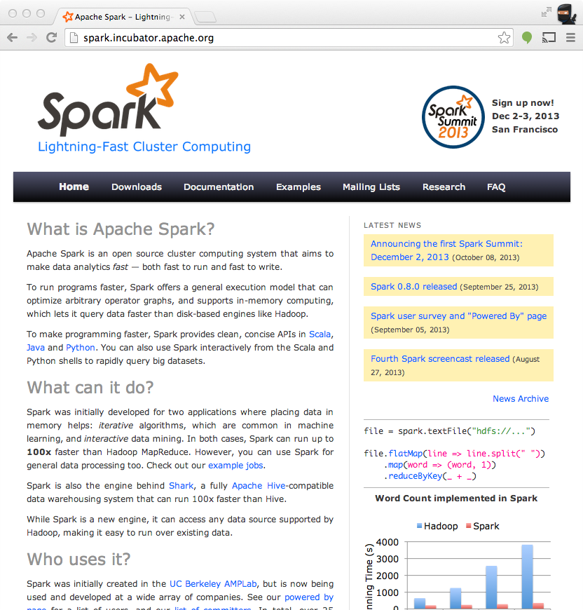
Get Started
Up and Running in a Few Steps
Download
Unzip
Shell
Project Resources
Examples on the Project Site
Examples in the Distribution
Documentation
http://spark.incubator.apache.org

